Slide 1
CST-411
Model Fitting

Slide 2

License and References
This work is licensed under a Creative Commons Attribution-NonCommercial-ShareAlike 4.0 International License
Fore more details: https://creativecommons.org/licenses/by-nc-sa/4.0/
The author is indebted to the generosity of others who have provided example problems and datasets. Where appropriate, external sources are cited both in the slides and in Jupyter Notebooks
Images from around the Web are also used to help convey concepts
Content that is reused in these slides is either open licensed or, as I understand it, meets the Fair Use Doctrine for educational reuse.

Slide 3
License and References
My university offering of this course has an introductory Python course as a prerequisite
That course uses
Python Programming: An Introduction to Computer Science 2010, 3rd Edition, John Zelle, Franklin, Beedle & Associates Inc., ISBN 9781590282755
At times, example problems from that text will be cited

Slide 4
Goodness of fit
Previously, we modelled a physical system using Monte Carlo simulations.
In those situations we created pseudo-random numbers to mimic probabilistic events.
This week we look at data from experiments and how we can fit a model to those data sets.
Why?
Real-world experiment data is messy – measurements are imprecise.
We have error bars and uncertainty.
A common technique is to see which model – line/function – best fits our data and can be used to describe the physical system we are experimenting with

Slide 5
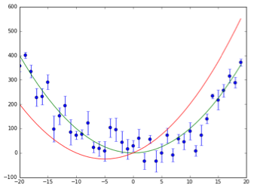
Goodness of fit
The blue dots represent observations
The bars represent errors (uncertainty in each measurement)
There seems to be a trend to our observations
We’d like to know which line – model – best fits our data
Is it the green one or the red one?

Slide 6
Goodness of fit
The green line is a pretty good fit to the data
The red one not so much.
But, that’s not enough for our purposes
We need a way to quantitatively measure which one of the lines is the better fit to the data.
A useful statistic for this purpose is the chi-squared statistic.
It’s a measure for the distance of the data points to the model, divided by the error bar of the data points.

Slide 7
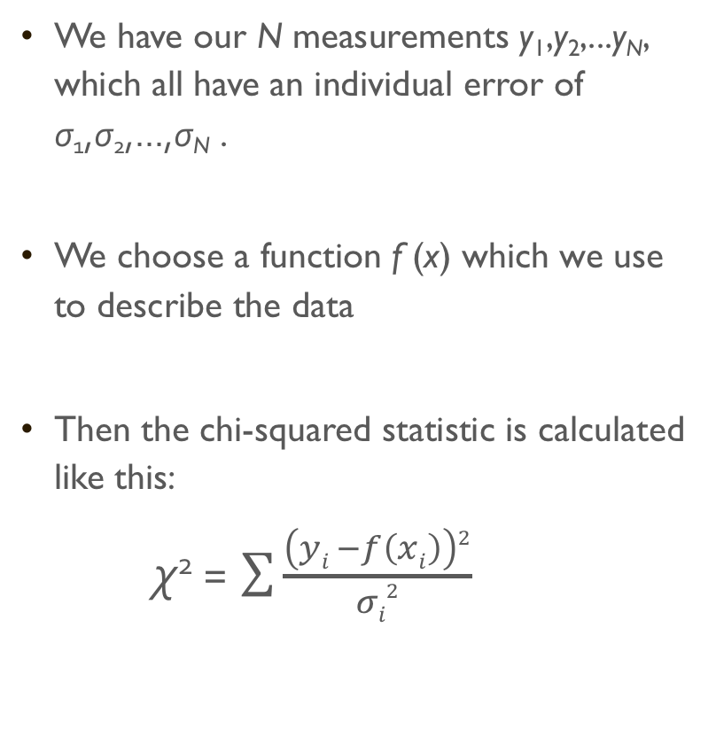
Goodness of fit
We have our N measurements y₁,y₂,...y_{N}, which all have an individual error of σ₁,σ₂,...,σ_{N} .
We choose a function f (x) which we use to describe the data
Then the chi-squared statistic is calculated like this:
χ² = $\sum{\frac{\left(yi −f\left(xi\right)\right)2}{σi2}}$

Slide 8
Goodness of fit
An example Python program to do this was written by Dr. Katja Poppenhaeger [1]
import numpy as np import matplotlib.pyplot as plt %matplotlib inline
# generate data
# a line that is a pretty good fit:
y_1 = x**2
# a line that is a pretty bad fit:
y_2 = x**2 + 10*x
plt.plot(x, y_1)
plt.plot(x, y_2)
chi_1 = ((y - y_1)**2/yerror**2).sum()
chi_2 = ((y - y_2)**2/yerror**2).sum()
Notice that we don’t need a loop here. This is a benefit we get from numpy
[1] https://star.pst.qub.ac.uk/wiki/doku.php/users/kpoppenhaeger/phy1024/start

Slide 9
Lists and Numpy arrays
We can not subtract, add, multiply, or divide standard lists in Python. For example, this will generate an error
X = [100, 200, 300]
Y = [10, 20, 30]
Z = X-Y
But, this is such a common thing to do in scientific computing that numpy has created a special list called an array that does allow this

Slide 10
Lists and Numpy arrays
import numpy as np
x = [100, 200, 300]
y = [10, 20, 30]
x = np.array(x)
y = np.array(y)
z = x-y
Or you can save some typing by putting the list directly into np.array()
x=np.array([100, 200, 300])
y=np.array([10, 20, 30])
z=x-y

Slide 11
Lists and Numpy arrays
The benefit here is that multiplication, addition, addition, and subtraction are understood by numpy arrays
The operation is performed with the corresponding elements (indices) in each list
x[0]-y[0], x[1]-y[1], x[2]-y[2], etc., etc.
Thus, it’s important that your arrays are of the same size
x=np.array([100, 200, 300])
y=np.array([10, 20, 30])
z=x-y

Slide 12
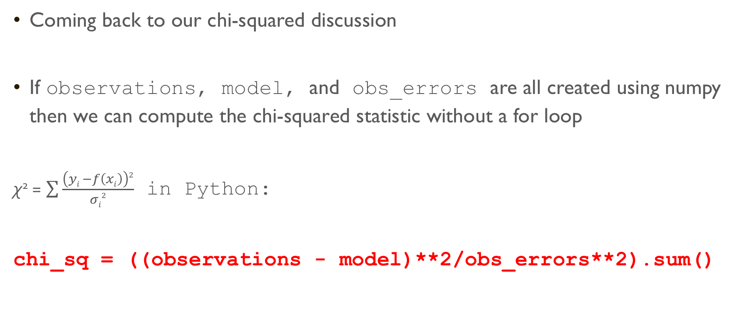
Goodness of fit
Coming back to our chi-squared discussion
If observations, model, and obs_errors are all created using numpy then we can compute the chi-squared statistic without a for loop
χ² = $\sum{\frac{\left(yi −f\left(xi\right)\right)2}{σi2}}$ in Python:
chi_sq = ((observations - model)**2/obs_errors**2).sum()

Slide 13
Goodness of fit
For the example data given we end up with
Chi-squared for green line: 119.21
Chi-squared for red line: 1372.09
Of these two models, the green line best fits our observations and best describes the physical system we are working with

Slide 14
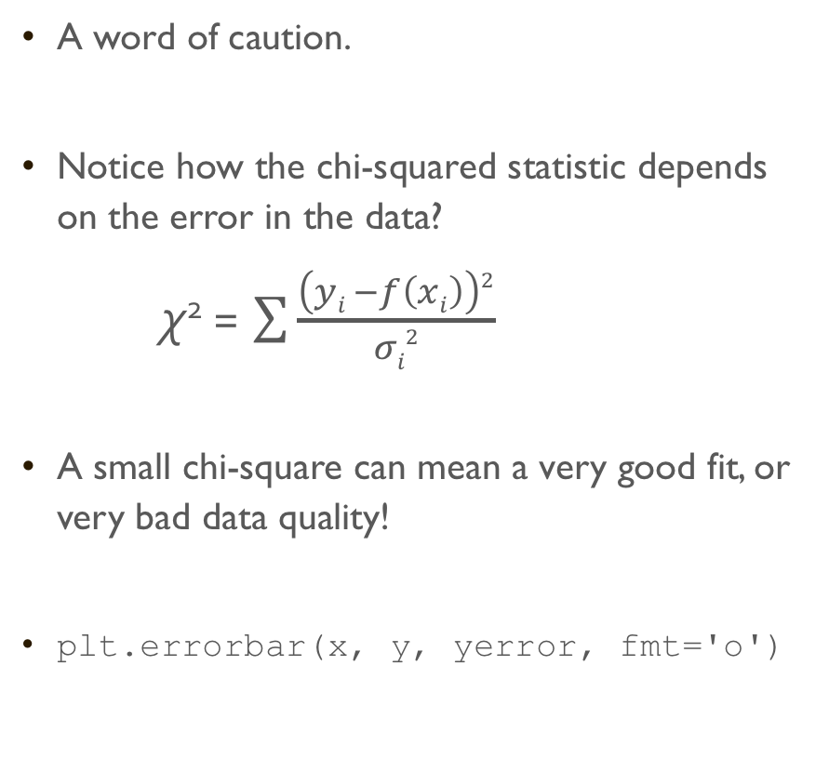
Goodness of fit
A word of caution.
Notice how the chi-squared statistic depends on the error in the data?
χ² = $\sum{\frac{\left(yi −f\left(xi\right)\right)2}{σi2}}$
A small chi-square can mean a very good fit, or very bad data quality!
plt.errorbar(x, y, yerror, fmt='o')

Slide 15
exoplanets
An exoplanet is a planet orbiting a star other than our Sun
To date, thousands of exoplanets have been detected
We can’t observe the planets directly – they are too small and too dim compared to the stars they orbit
But, we can infer they are there by studying the light output of a star

Slide 16
Exoplanets
Suppose we measure the brightness of a star
If there is no planet, or the planet is not in front of the star, then we’d expect to see a flat line – the brightness not changing
If there’s a planet, then the brightness will dip when the planet passes in front of the star
How much it dips tells us a lot about the size of the planet compared to the size of the star
Image credit: Andrew Vanderburg, Harvard

Slide 17
Exoplanets
NASA has a mission named Kepler, which is looking for exoplanets
Kepler provides very high-quality measurements, but they’re not perfect. There is still uncertainty around each point
Finding the best fit to the data will tell us the properties of the planet(s)
Chi-squared statistic will help us do that

Slide 18
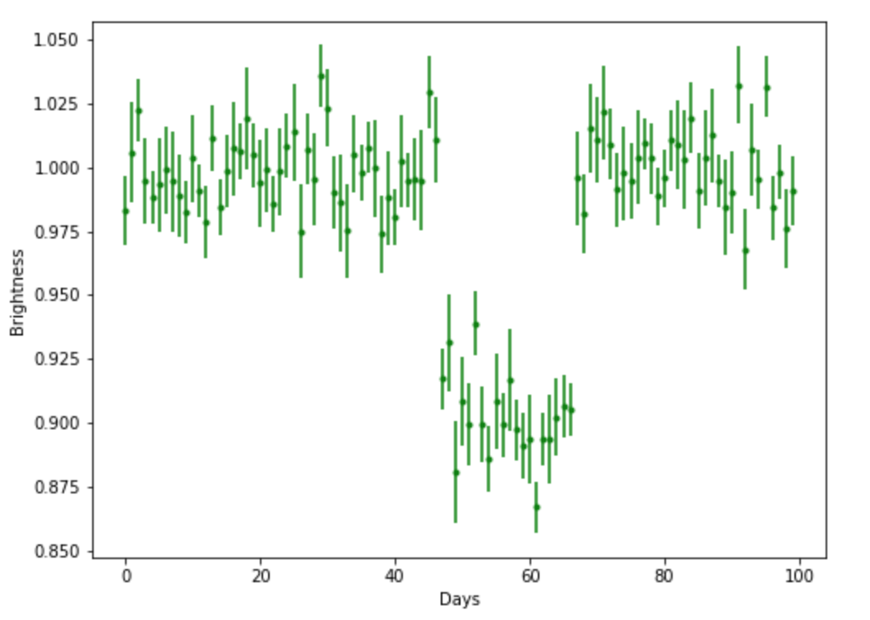
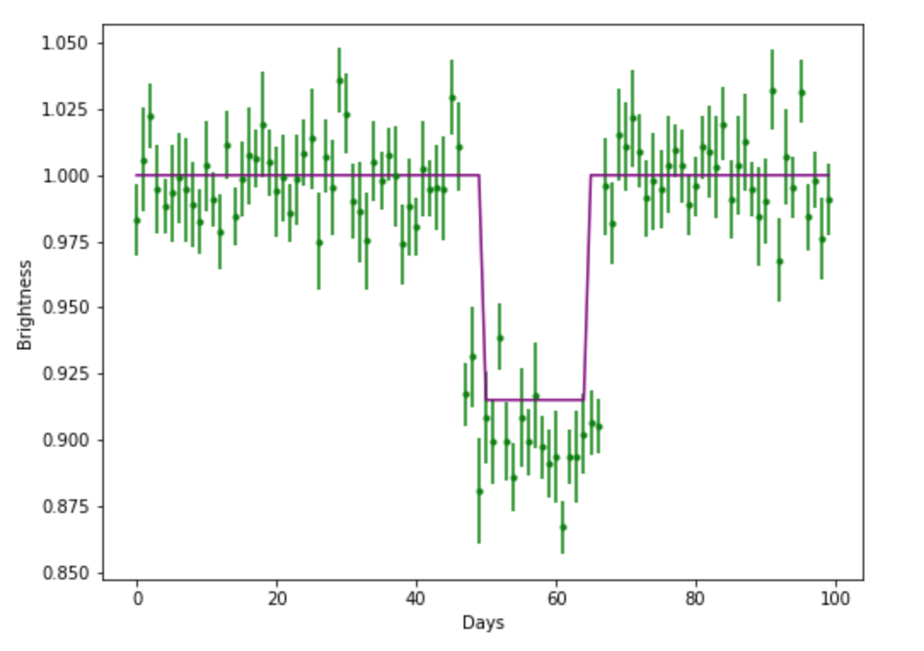
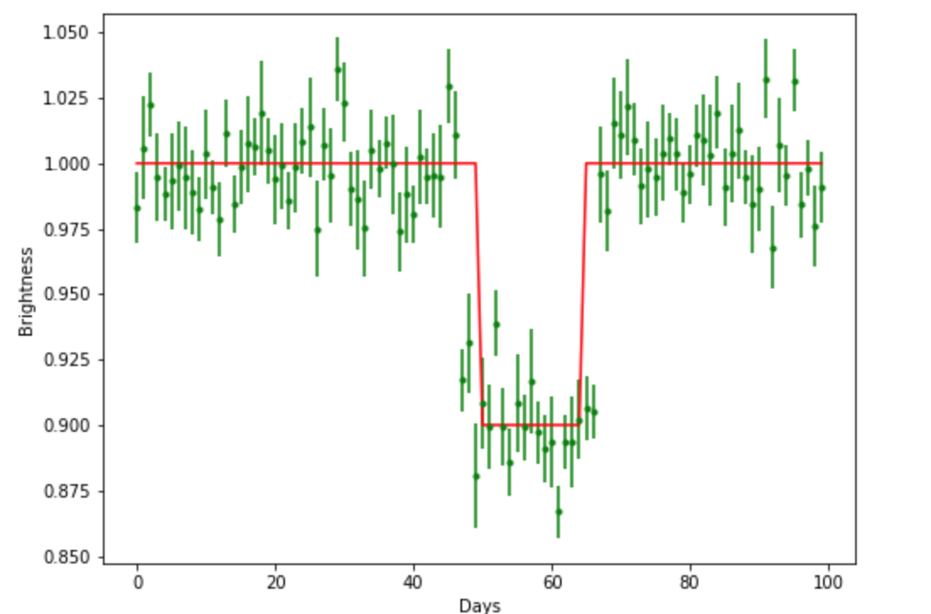
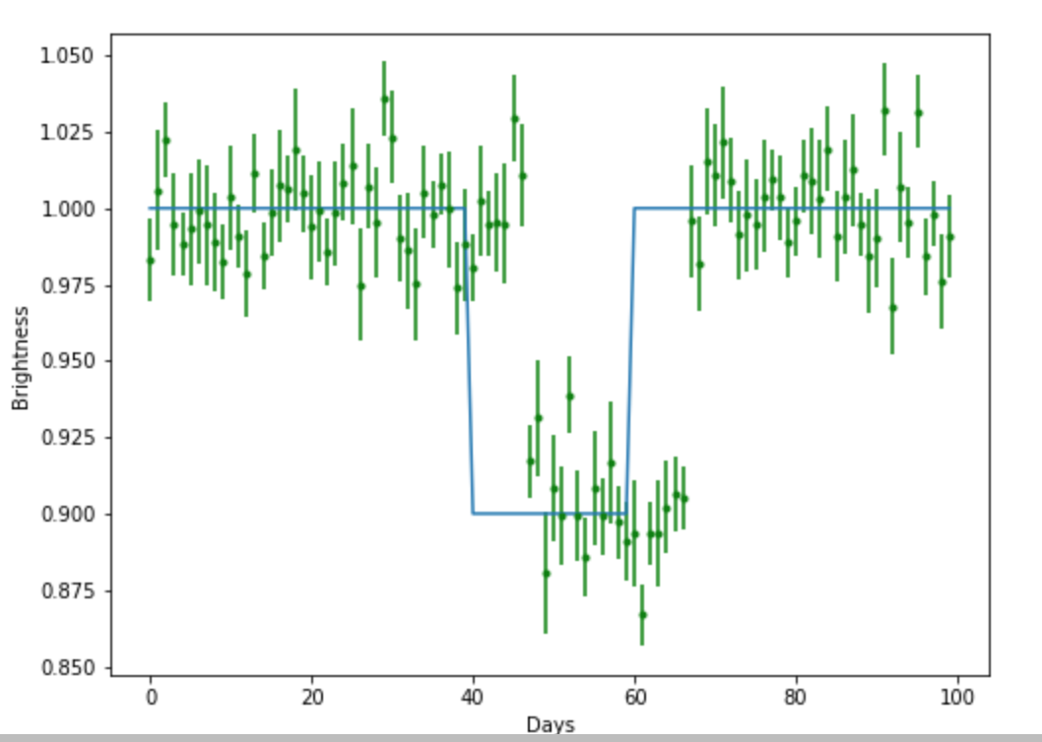
Exoplanets
Your task – given exoplanet data like this
What is the best fit model to the data?
Once you’ve found the best fit model
What does it tell us about the properties of the planet?

Slide 19
Exoplanets
There is a Jupyter Hub notebook named exoplanets.ipynb that has sample light curve data ready to go
You are asked to
Follow the example given to create several models
There are an infinite number of models to try and we can’t get through them all
Try to create at least 5 models that you think are reasonable
Compute chi-squared for each of your models and the star light data given
Compare with you classmates to see if anyone has a lower chi-squared model
Once we determine the best model to use, determine how deep and how wide the model is
We’ll use this in the next part to get more information about the planet

Slide 20
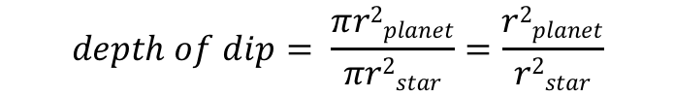
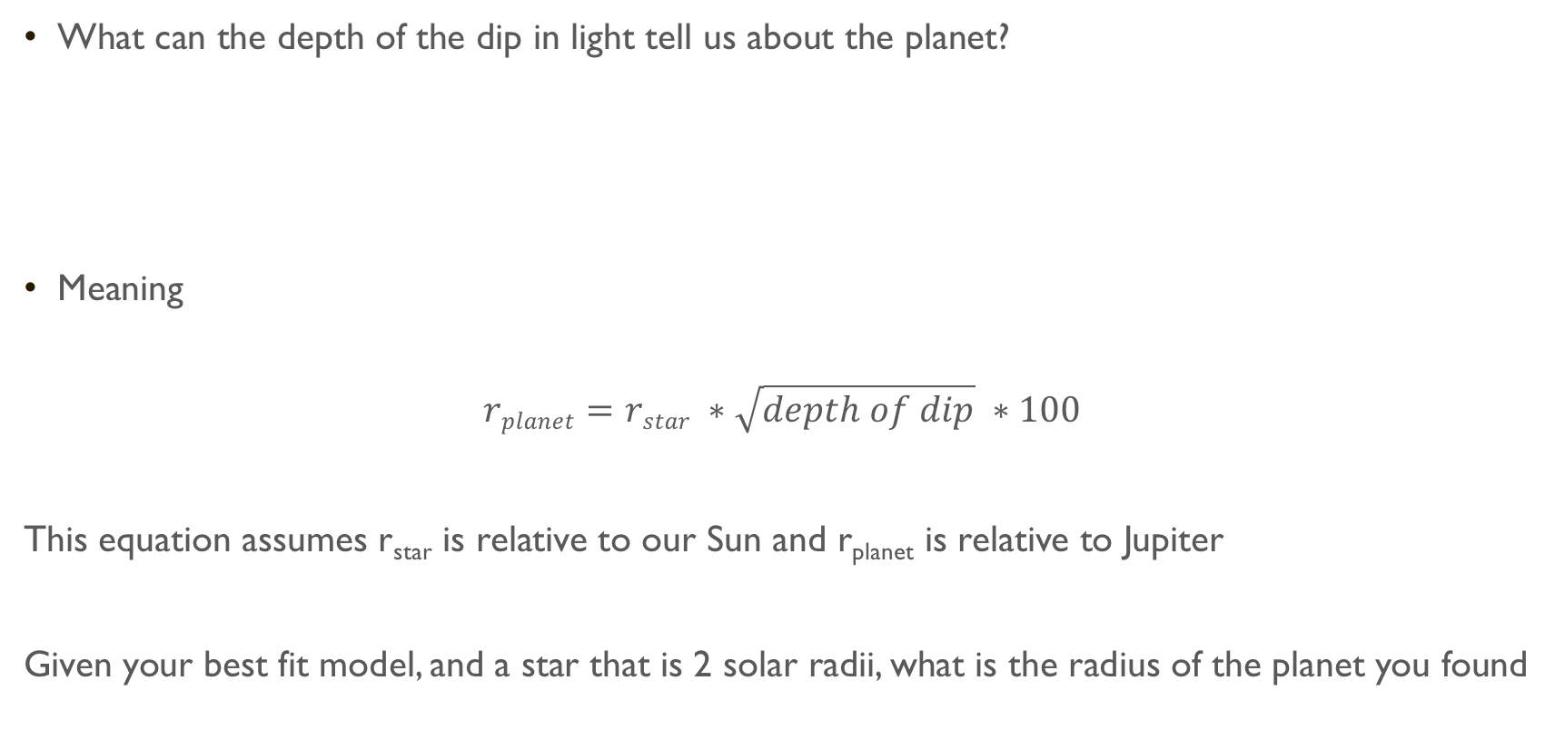
Exoplanets
What can the depth of the dip in light tell us about the planet?
Meaning
$$rplanet=rstar ∗\sqrt{depth of dip} ∗100$$
This equation assumes r_{star} is relative to our Sun and r_{planet} is relative to Jupiter
Given your best fit model, and a star that is 2 solar radii, what is the radius of the planet you found
$$depth of dip= \frac{πr2planet}{πr2star}=\frac{r2planet}{r2star}$$

Slide 21
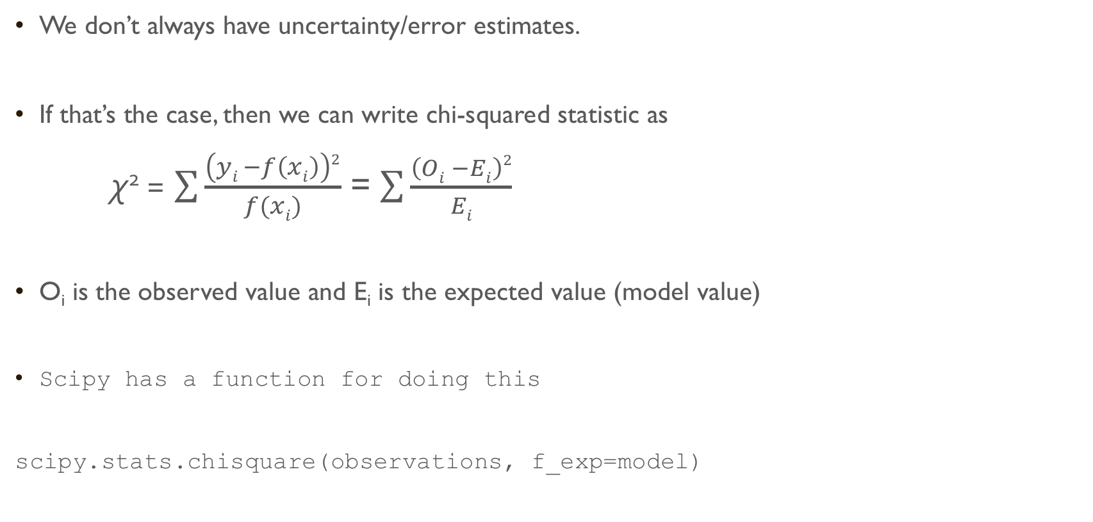
Goodness of fit
We don’t always have uncertainty/error estimates.
If that’s the case, then we can write chi-squared statistic as
χ² = $\sum{\frac{\left(yi −f\left(xi\right)\right)2}{f(xi)}}$ = $\sum{\frac{\left(Oi −Ei\right)2}{Ei}}$
O_{i} is the observed value and E_{i} is the expected value (model value)
Scipy has a function for doing this
scipy.stats.chisquare(observations, f_exp=model)

Slide 22
Let’s try this out on some real Kepler data
There is a CSV data file containing Date and Flux (Brightness) at
https://narock.github.io/teaching/CST-411/kepler_lightcurve_206103150_c3.txt
The file is comma separated and has two columns BJD and Flux
BJD stands for Barycentric Julian Date (BJD) and is a time column. Julian day (JD) is a continuous count of days since the beginning of the Julian Period and is astronomers for easily calculating elapsed days between two events. Julian day number 0 is assigned to the day starting at noon on Monday, January 1, 4713 BC.
BJD corrects JD for differences in the Earth's position with respect to the center of the Solar System. Due to the finite speed of light and the changing position of Earth, Julian day calculations need correcting.
Flux – change per unit time. Light Flux = change in brightness over time

Slide 23
Let’s try this out on some real Kepler data
There is a CSV data file containing Date and Flux (Brightness) at
https://narock.github.io/teaching/CST-411/kepler_lightcurve_206103150_c3.txt
Read the data into a notebook
Visualize the light curve
The data show many transits of the planet
Subset the table to be just the first transit (BJD > 2149.0 and BJD < 2151.0)
Create a model for the first transit and compute chi-square using the equation
Confirm your result using scipy.stats.chisquare(d['Flux'], f_exp=model)
Determine the radius of the planet
How far apart are the transits?
Use this information and M = ( a³ / p² ) to determine how far away from the star the planet is
M is the mass of the star relative to our Sun, which is 1.11
p is the orbital period of the planet in years
a is the distance of the planet from the star in Astronomical Units (AU), Earth is 1 AU from the Sun

Slide 24
Data sources
The data that you just used came from NASA’s Kepler space telescope
All Kepler data is freely and publicly available
If you’d like to hunt for more planets check out:
Barbara A. Mikulski Archive for Space Telescopes - http://archive.stsci.edu/k2/epic/search.php
The specific data we just looked at was EPIC 206103150
You can also find it here: https://www.cfa.harvard.edu/~avanderb/allk2c3obs.html
That particular star actually has 4 confirmed planets
https://en.wikipedia.org/wiki/WASP-47#Planetary_System

Slide 25
Machine learning
Sometimes we have one or two models we’d like to compare our observations against
Remember our mini-project and the atoms decaying?
In cases like that, where you have observations (or a simulation) and a known theory, then using one of the aforementioned chi-squared equations is the way to go
However, there are other cases where we don’t have a specific model/theory to compare against
Cases like the planet hunting would be much easier if we could instead tell the computer what we’re looking for and have it try many different combinations.

Slide 26
Machine learning
This is where we start to get into the field of machine learning
Machine learning = having a computer “learn” from data
The “learning” involves having the computer apply statistics, like the chi-squared statistic, repeatedly while slightly varying the model each time. Eventually, the computer will settle on a model with the best fit to the observations
Pros – computers don’t get tired. They’ll happily try millions of combinations for us
Cons – the computer is just following an algorithm. What you get back may not be the “best”, it’s just the “best” the computer could find. Also, poor observations will impact your results

Slide 27
Machine learning
Scipy is the go-to library for this sort of thing (at least initially, scikit-learn as you get more advanced)
There are lots of ways to do this sort of thing in Scipy – lots
We’re going to use scipy.optimize.curve_fit which is a general purpose routine
This routine will work for many different types of models (straight lines, quadratics, sines, cosines, etc.) and is a good place to start
It works quickly for datasets with less than about one million data points
Above ~1 million observations there are better algorithms – Remember time complexity!

Slide 28
Machine learning
Study done by Tirthajyoti Sarkar:
https://medium.freecodecamp.org/data-science-with-python-8-ways-to-do-linear-regression-and-measure-their-speed-b5577d75f8b

Slide 29
Scipy curve_fit
Let’s try out scipy’s curve_fit capabilities using a real example
You’ve built the next great website
Lots of people are buying memberships to your website to get exclusive content!
You’d like to know
Is there a relationship between how long someone has been a member and how long they stay on the site?
If the answer is ‘yes’, then what is the ‘best’ mathematical function (model) that describes the relationship?

Slide 30
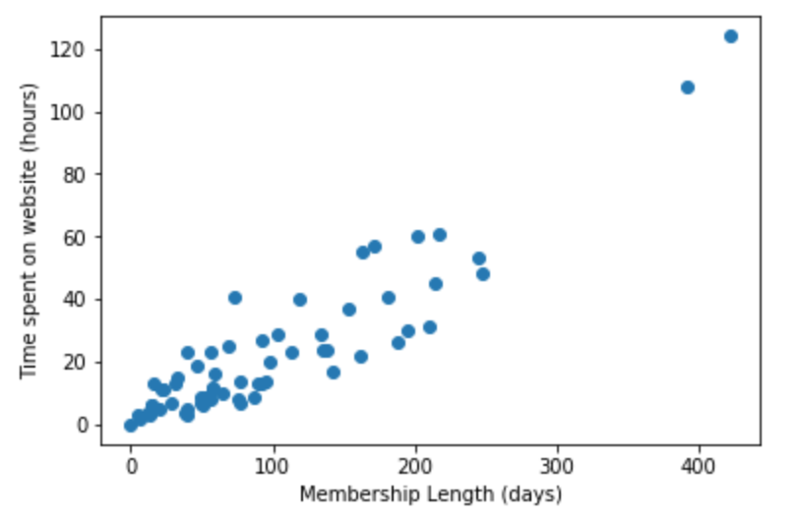
Scipy curve_fit
Visualizing the data suggests a linear relationship
But, what which line best fits our observations?
The red one? The green one?
We could manually try many different lines, similar to what we did with the exoplanet observations
Alternatively, we could ask the computer to try lots of lines and find the best one for us

Slide 31
Scipy curve_fit
Before we actually do that, let’s look at why
Why do we care which line best fits the observations?

Slide 32
Scipy curve_fit
If the red line is the ‘best’ fit then we can use it to predict how long someone will stay on the website where we don’t have data.
Like here!
Before we actually do that, let’s look at why
Why do we care which line best fits the observations?
It can be used for prediction: y = mx + b
If we know the equation of the best fit line then we can make predictions where we don’t have data.
It can also lead us to a theoretical/practical understanding of what’s happening

Slide 33
Scipy curve_fit
So, how do we ask the computer to find the best model for us?
First, we need to give it some guidance. We need to suggest a type of model to try. Otherwise, the number of possible functions and shapes to try is infinite (i.e. sines, cosines, exponentials, straight lines, etc.)
For this problem, it looks like a straight line is the best choice. We’ll start there.
Recall that a straight line is described by: y = m*x + b
Where m is the slope and b is the y-intercept
We want to provide scipy with this equation and ask it to find the best values for m and b

Slide 34
Scipy curve_fit
The first step is to define a function that returns y for various values of x, m, and b
curve_fit will use this function repeatedly as it explores different values
def line(x, m, b):
return m*x + b
Our function will take x (a list), m (single valued variable), and b (single valued variable) as inputs and output a list of y values
The output of this function is a line that curve_fit will compare against our observations
This process is repeated until curve_fit identifies the ‘best’ line to choice

Slide 35
Scipy curve_fit
Once we’ve defined a function to use, we can pass the function and the data to curve_fit
import scipy.optimize as sp
def line(x, m, b):
return m*x + b
solution, covar = sp.curve_fit(line, data['Days'], data['Time’])
curve_fit returns two results: the ‘best’ values to use for m and b and the covariance matrix.
solution is a list containing the ‘best’ fit values (the order is the same as the function inputs)
covariance matrix is used to determine uncertainty – more on this in the homework

Slide 36
Web site line fit
The website data is at: https://narock.github.io/teaching/CST-411/web_site.tsv
Use Pandas library to read the data into a notebook
Make a scatter plot of the data
Fit the data to a straight line
What are the slope and y-intercept of the ‘best’ fit line?
Plot the ‘best’ fit line on top of a scatter plot of the data

Slide 37
Web site line fit
So, how did we do?
Our model line seems to nicely fit our data points
But, we’d like a means to quantify how well our model fits our data
This is where we use the R-squared statistic, or in math jargon, coefficient of determination
R-squared is like Chi-squared, it measures how much our line deviates from touching all the points
R-squared values range from 0 to 1
0 = bad fit to the data
1 = perfect fit to the data

Slide 38
Web site line fit
Steps to get R-squared
Compute the residuals = difference between y_observations and model_predicted_y_values
Sum up the square of the residuals (ss_res)
Compute the mean of y_observations
Compute ss_tot, the sum (y_observations – mean_y_observations)²
Finally, compute R-squared = 1 – (ss_res / ss_tot)
Or, in code…

Slide 39
Web site line fit
import numpy as np
ymodel = … # output of curve_fit
residuals = y_obs - ymodel
ss_res = np.sum(residuals**2)
ss_tot = np.sum( (y_obs - np.mean(y_obs))**2 )
r_squared = 1 - (ss_res / ss_tot)
print(r_squared)

Slide 40
Web site line fit
Returning to our website data
How good is our fit? What is the R-squared value
Let’s use our ‘best’ fit model to make predictions
How long will someone who’s been a member for 300 days stay on our website?
How long will someone who’s been a member for 500 days stay on our website?

